Slide 1

Computational Fluid Dynamics

Slide 2
CFD Explained: From Basics to Results
Explore the fundamentals, equations, applications, and interpretation of CFD.
1
2
Introduction
How CFD Works
What is CFD and why it's important.
Core equations and principles.
3
4
Turbulence
Applications
Models and simplifications for real-world flows.
Using Autodesk CFD.
5
6
Key Terms
Results
Understanding aerodynamic coefficients and other jargon.
Interpreting CFD outputs for design insights.

Slide 3

Welcome to the World of CFD
Today, we dive into Computational Fluid Dynamics (CFD).
CFD is a computer-based method for studying how fluids — like air and water — move around objects. Instead of running expensive wind tunnel tests or building prototypes, we create a virtual environment where the computer simulates fluid motion.

Slide 4
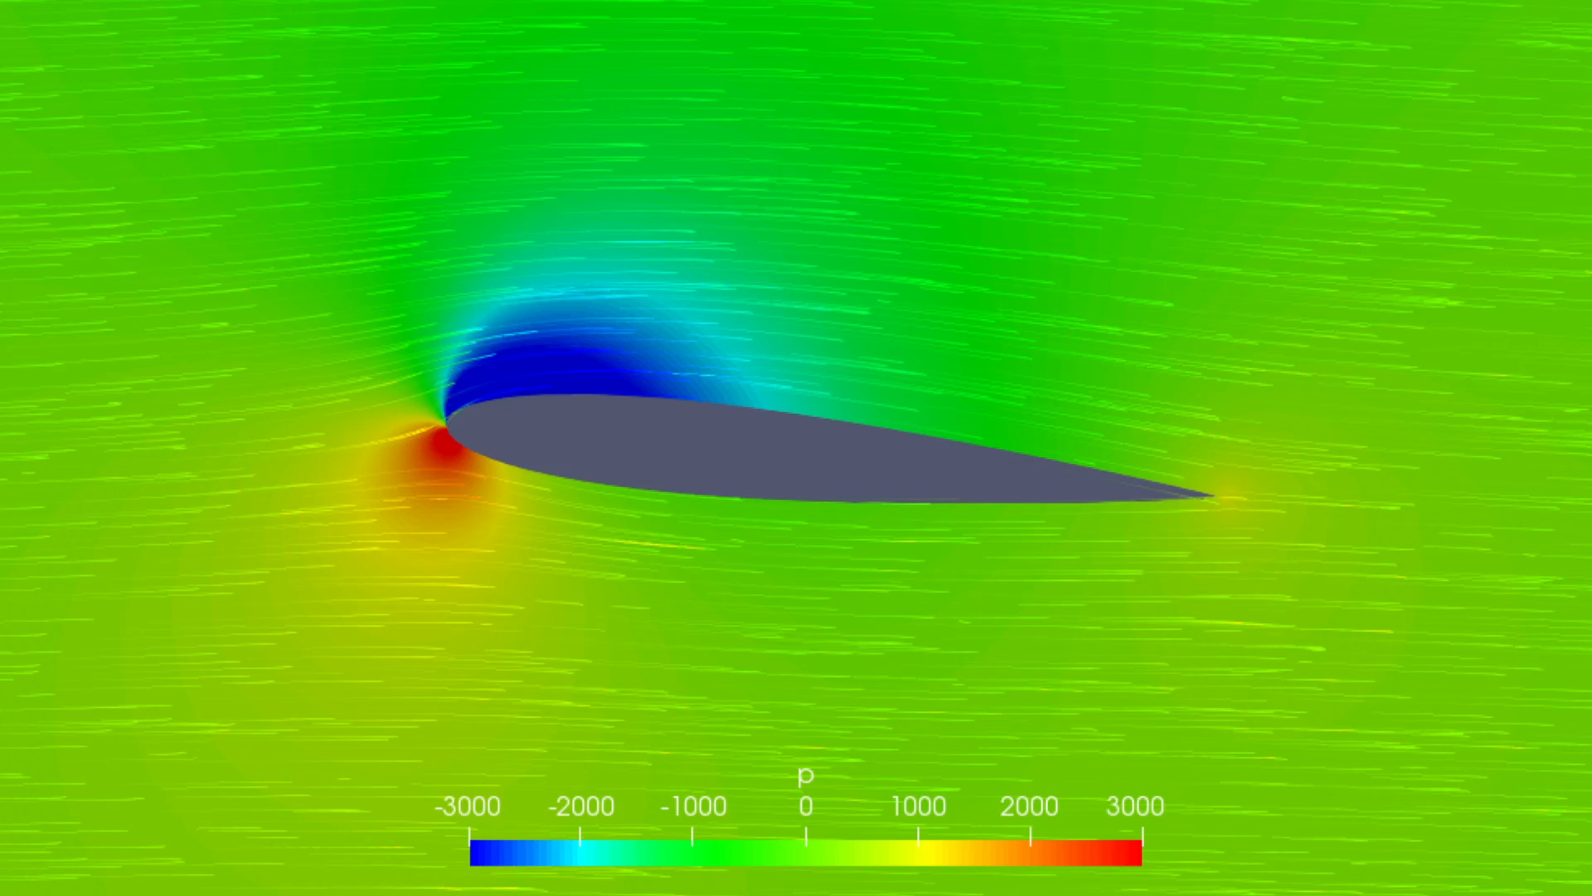
Part 1: What is CFD?
CFD is a computer-based method for studying fluid motion.
It creates virtual environments to simulate airflow, replacing expensive physical tests.
With CFD, we visualize:
Fluid speed and pressure
Lift and drag forces
Flow patterns (smooth or turbulent)

Slide 5


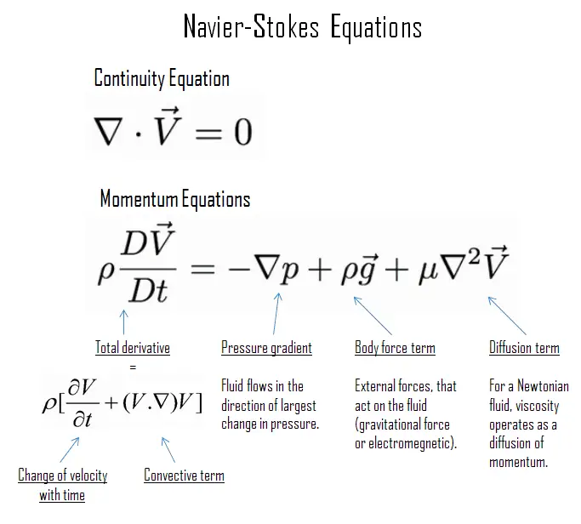

Part 2: How CFD Works
CFD solves the Navier–Stokes equations, fundamental laws governing all fluid behavior.
Conservation of Momentum
Conservation of Energy
Describes energy changes due to fluid motion and heat exchange.
Newton's laws for fluids: balances inertia, pressure, and viscosity.
Conservation of Mass
Fluid inflow equals outflow; no creation or disappearance.
These equations are complex, especially for turbulence,
requiring numerical methods and models for practical solutions.

Slide 6

Part 3: Turbulence & Simplifications
Most real-world flows are turbulent, full of varying swirling eddies.
Direct Numerical Simulation (DNS), while accurate, is often too computationally intensive for engineering timelines.
Engineers use turbulence models like:
k–ε model: Robust and efficient for general flows.
k–ω SST model: More accurate near walls and for predicting flow separation.
These models make CFD practical without sacrificing crucial accuracy.

Slide 7
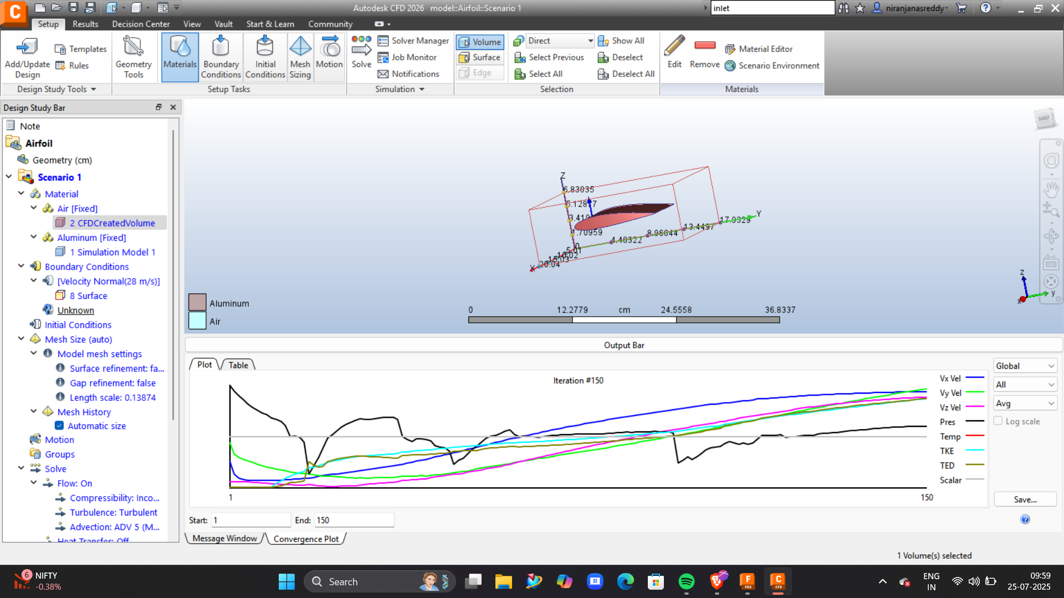
Part 4: Autodesk CFD Applications
Autodesk CFD simplifies complex simulations:
Import Design
Load models like aircraft wings.
Define Domain & Properties
Set computational space, fluid properties.
Boundary Conditions
Specify inlet speed, outlet pressure.
Generate Mesh
Divide space into small calculation elements.
Run Simulation
Choose solver settings and execute.
Visualize Results
View velocity maps, pressure contours, force plots.

Slide 8
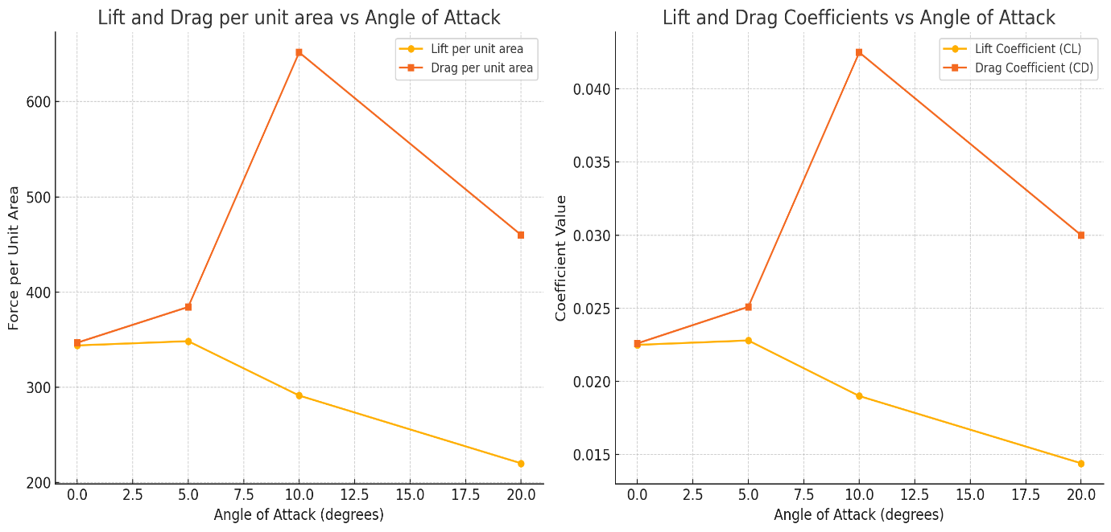
Part 5: Key Aerodynamic Terms
Two crucial dimensionless numbers in aerodynamics:
Coefficient of Lift (CL)
Measures lift efficiency based on shape, speed, and flow density.
Compares lift performance across designs, independent of size/speed.
Coefficient of Drag (CD)
Measures aerodynamic resistance, how much a shape slows flow.
CL focuses on lift efficiency; CD on drag penalty. Both are critical for performance and efficiency-focused designs.

Slide 9

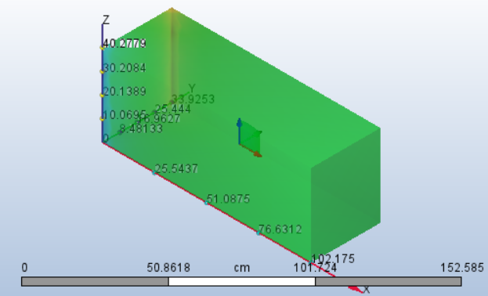
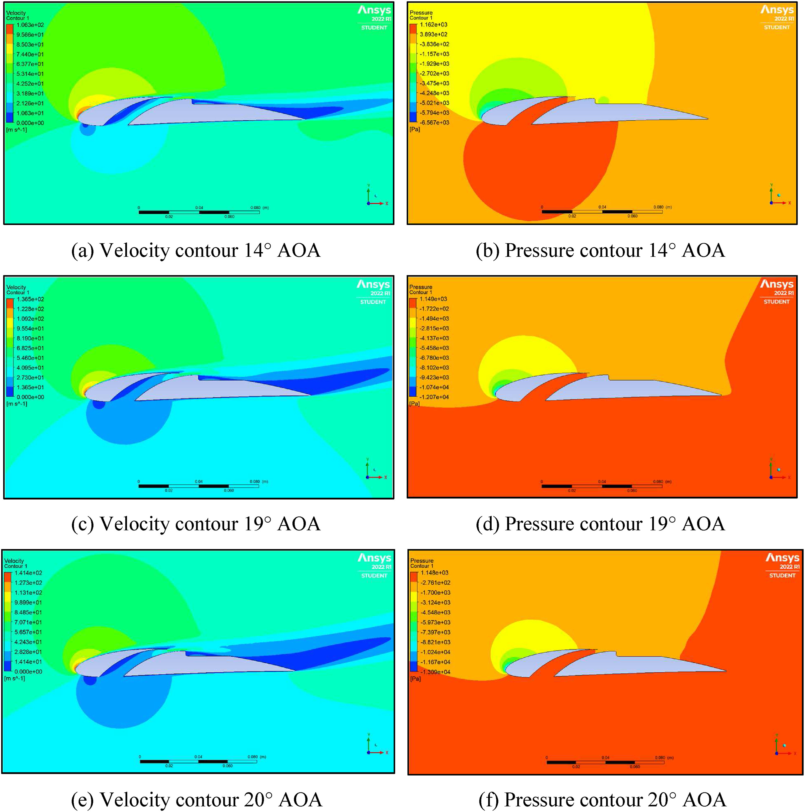
Part 6: Other CFD Terms
Beyond CL and CD, these terms are frequently used:
Dynamic Pressure (q)
Angle of Attack (AoA)
Pressure due to fluid motion: density times velocity head.
Tilt of the wing relative to airflow.
Reynolds Number
Boundary Layer
Predicts laminar or turbulent flow behavior.
Thin layer of fluid next to surface where viscous effects dominate.

Slide 10
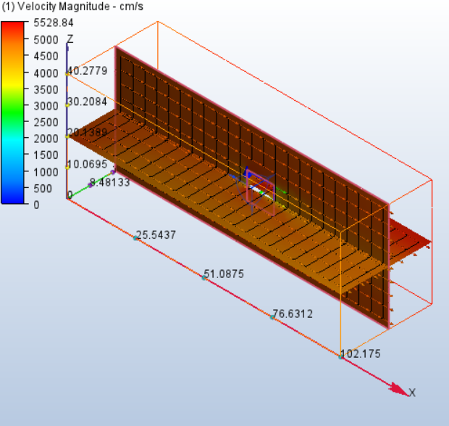
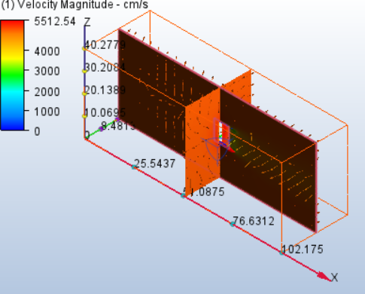
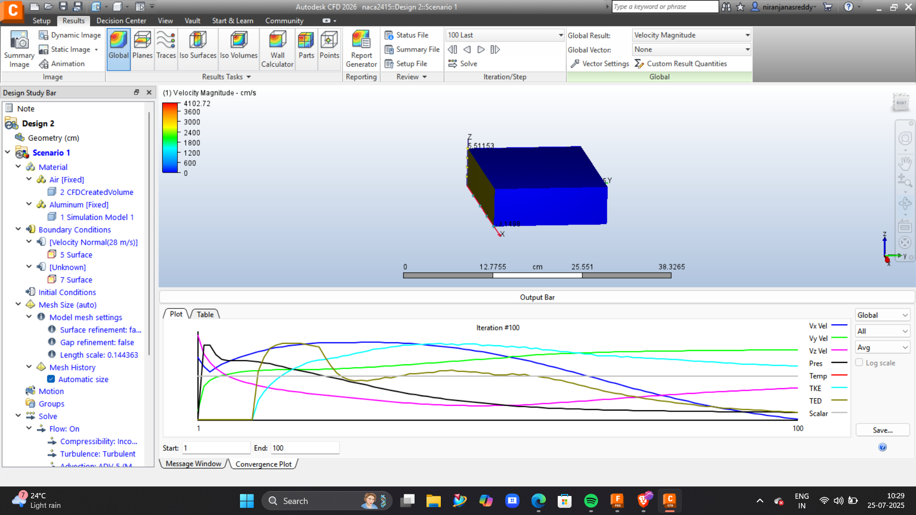
Part 7: Results You Get from CFD
Post-simulation, CFD offers rich insights:
Pressure Distribution: Identify high/low pressure zones.
Velocity Fields: Track flow acceleration/deceleration.
Flow Separation Zones: Pinpoint areas where air detaches (often causing stall).
Lift & Drag Forces: Directly calculated from surface pressure and shear stress.
From these, you can derive CL, CD, and the crucial lift-to-drag ratio, a direct measure of aerodynamic efficiency.

